Slide 1


Lamb & Goat Project

Slide 2
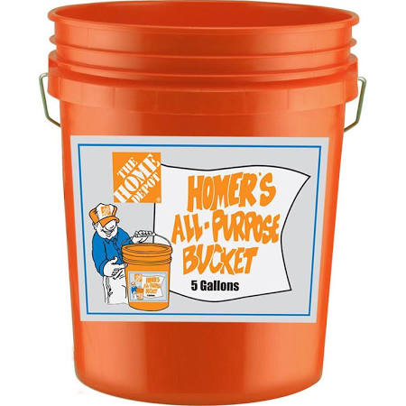
Required Materials & Supplies
5 Gallon Water Bucket

Slide 3
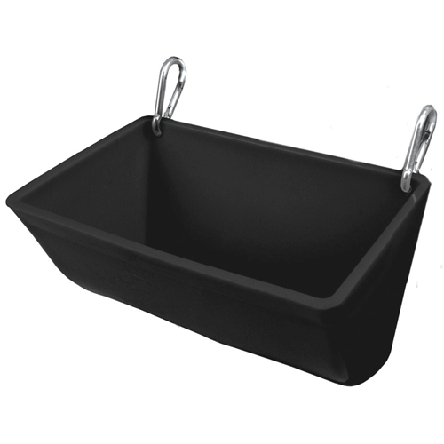
Required Materials & Supplies
14in. Clip on Feeder (Trough)

Slide 4
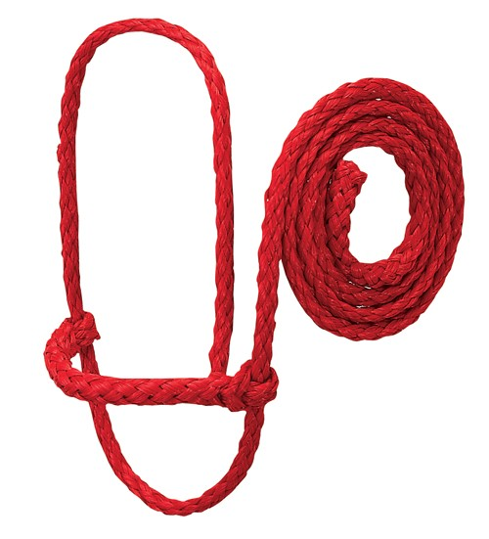
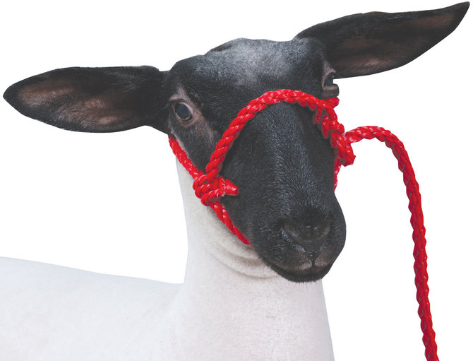
Required Materials & Supplies
Lamb/Goat Halter

Slide 5
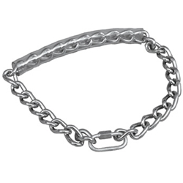
Required Materials & Supplies
Goat Chain
  *** FOR GOATS ONLY***

Slide 6
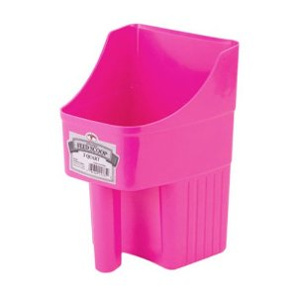
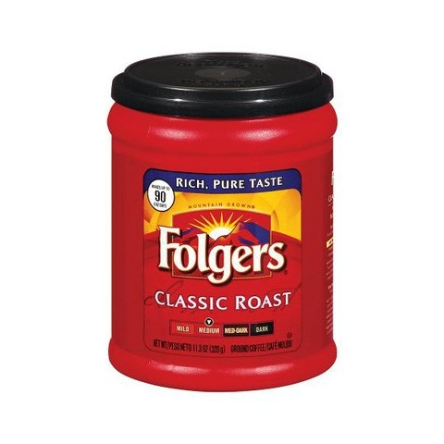
Required Materials & Supplies
3 Quart Feed Scoop (Holds 3 lbs. of feed)
  ** Not required but recommended**
A 16 oz. Coffee Can is sufficient (empty)
  1 Can = 1 lb. Feed

Slide 7
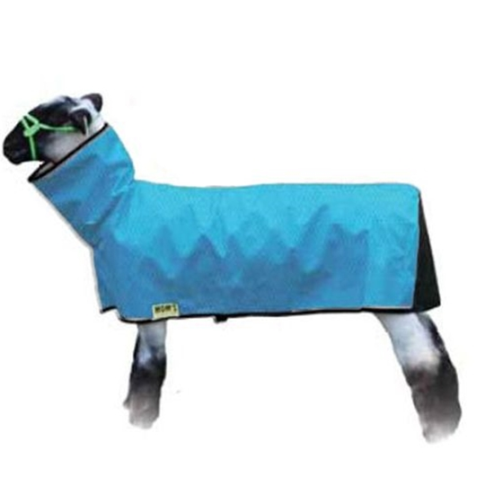
Required Materials & Supplies
Sheep/Goat Blanket (Cover)
Not needed until November

Slide 8
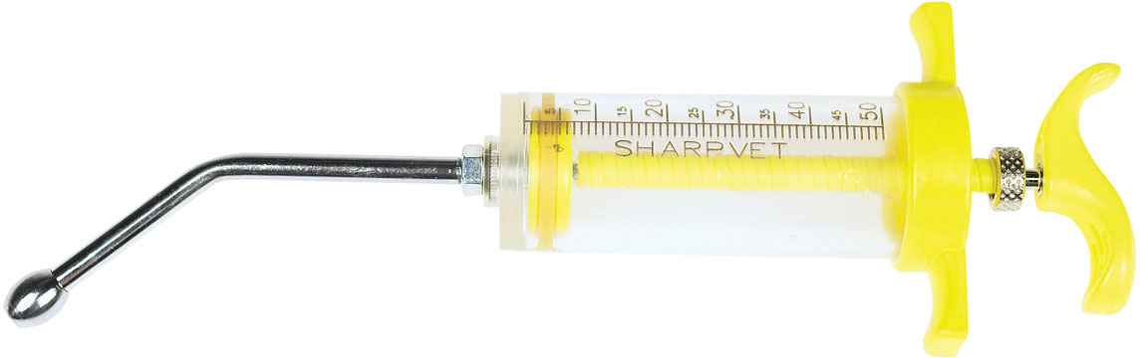
Required Materials & Supplies
50 cc Drench Gun
  **Optional**

Slide 9
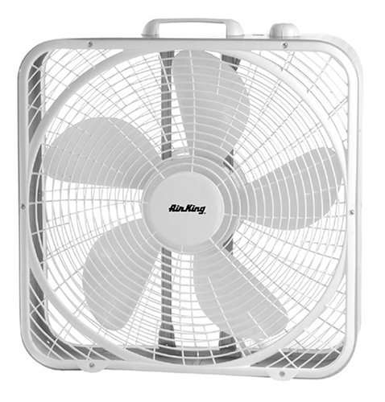
Required Materials & Supplies
Square Fan
  **Optional**
  For summer and spring heat waves

Slide 10
Local Feed Stores
Big Tex Feed & Pet Supply
  7102 Cullen Blvd, Houston, TX 77021
Wabash Feed & Garden Store
  5701 Washington Ave, Houston, TX 77007
Quality Feed & Garden
  4428 N Main St, Houston, TX 77009
Most of these stores will carry the type of feed that you will need for your lamb/goat.

Slide 11
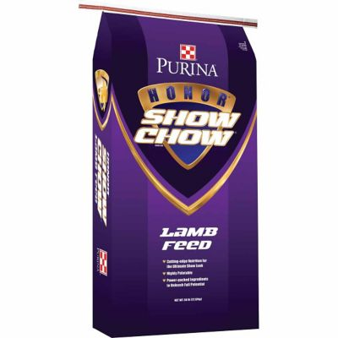
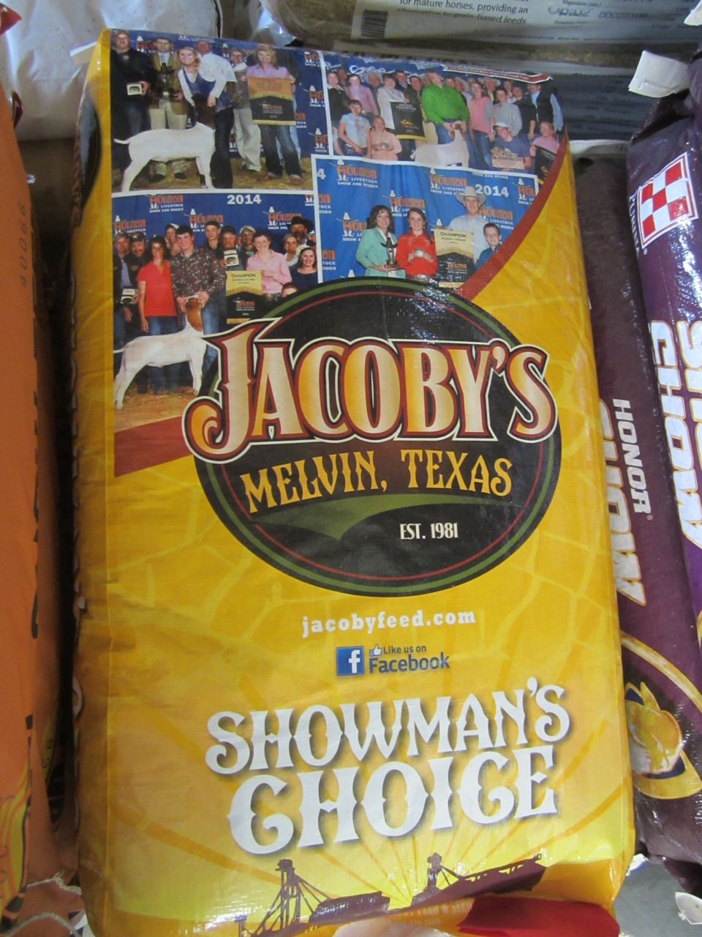

Lamb Feed Types
Purina Honor Show Chow- Lamb
Jacoby’s (may be found in select stores)
Producer’s Lamb Feed

Slide 12
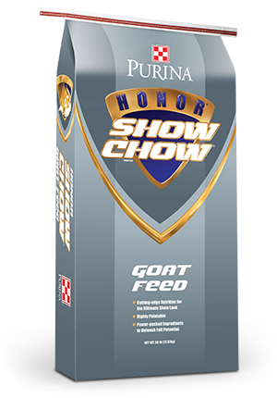
Goat Feed Types
Purina Honor Show Chow- Goat Feed
Jacoby’s Goat Feed
Producer’s Goat Feed

